Slide 1


Deep
Learning
Subset of ML which make the computation of multi-layer neural network feasible

Slide 2
AI vs ML vs DL
Artificial Intelligence
Artificial Intelligence
A technique which enables machines to mimic human behavior.
Machine Learning
Machine Learning
Subset of Al technique which use statistical tools to explore and analyze the data.
Deep Learning
Deep Learning
Subset of ML which make the computation of multi-layer neural network feasible

Slide 3
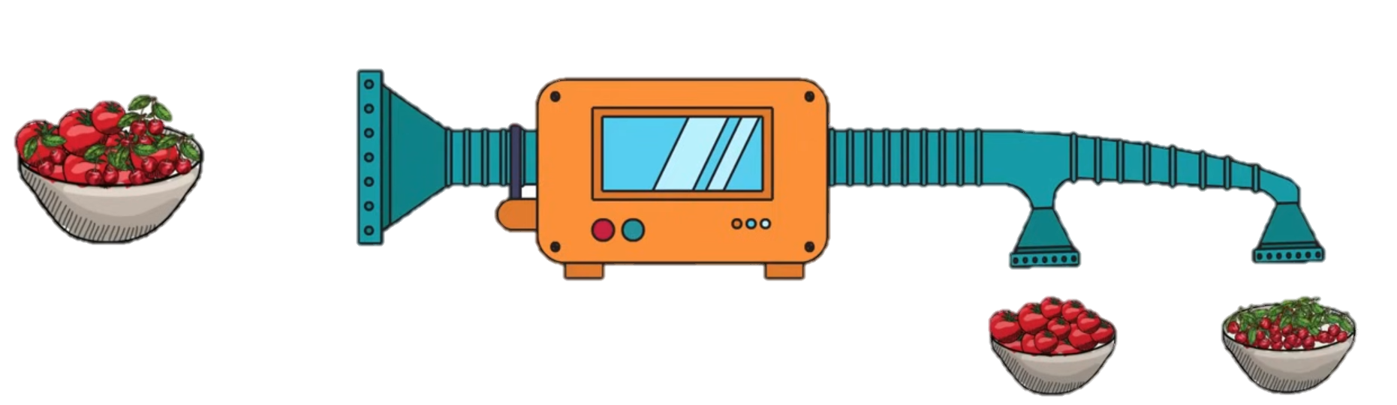
Machine Learning
Machine Learning

Slide 4
Machine Learning
Machine Learning

Slide 5
Machine Learning
Machine Learning

Slide 6
Machine Learning
Machine Learning

Slide 7





Machine Learning
Tomato
Cherry
Size
Type of stem
Machine Learning

Slide 8
Deep Learning
Machine Learning

Slide 9
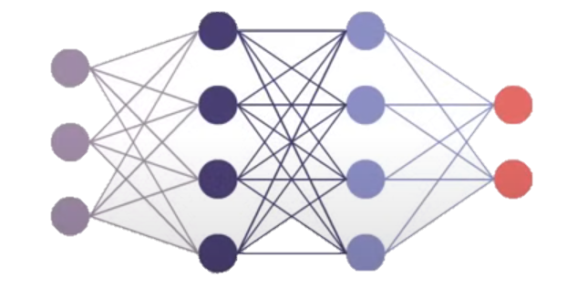

Deep Learning
Neural Network
Machine Learning

Slide 10
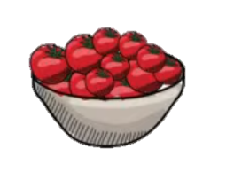



Deep Learning
Neural Network
Machine Learning

Slide 11
Deep Learning
Neural Network
Machine Learning

Slide 12




Deep Learning
Machine Learning

Slide 13

Deep Learning
Machine Learning

Slide 14

Deep Learning
Machine Learning

Slide 15
THANK YOU!
Any Question!

